Slide 1
Advancing the Equity Agenda at the Institution- and System-Level
Annual Trustees Convening | October 31, 2019

Slide 2
Pillars of Student Success
Advancing the Equity Agenda

Slide 3
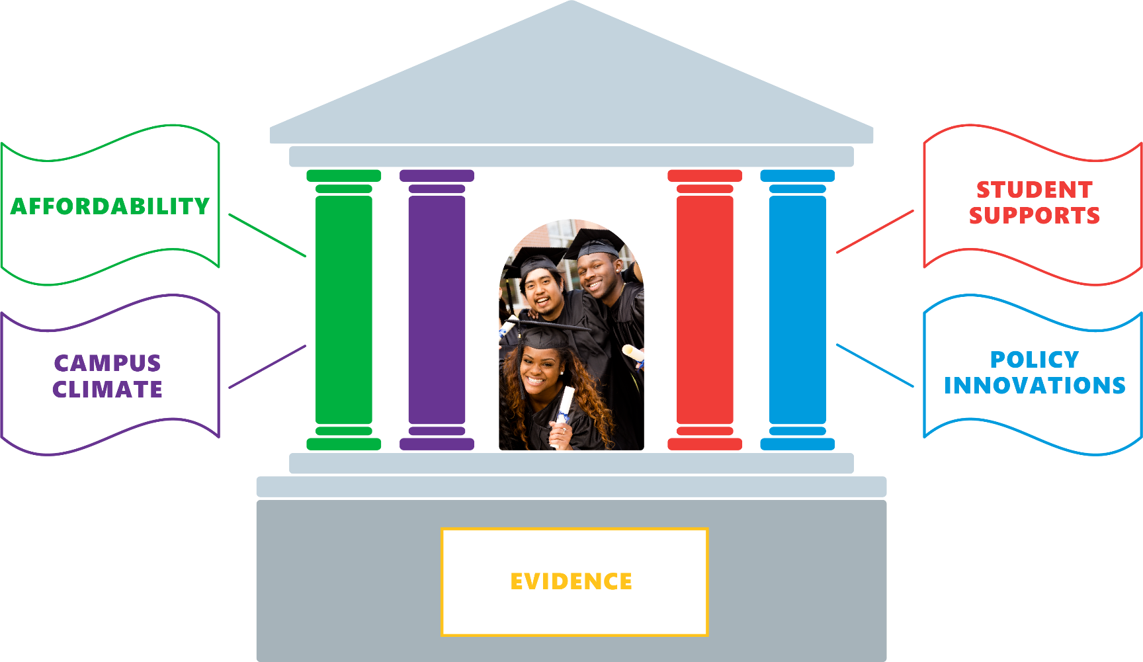
Pillars of Student Success
Advancing the Equity Agenda

Slide 4
Pillars of Student Success – System Level
Advancing the Equity Agenda
Affordability
Financial Aid Redesign
Campus Climate
Climate Surveys
Cultural Transformation
Evidence
Student Supports
Policy Innovations
Addressing Unmet Need
Scale Promising Practices
Internal Policy Audit
Data-Informed Decision-Making
Enhance Data Collection
Access to Benefits
Cultural Sustainability

Slide 5
Pillars of Student Success – Institutional Level
Advancing the Equity Agenda
Affordability
Campus Climate
Climate Surveys
Evidence
Student Supports
Policy Innovations
Internal Policy Audit
Data-Informed Decision-Making
Wraparound Services
Expand OER
Developmental Education Reform
Expand Early College
Expand PLA
Diversify Faculty Corps
Critical Lens to Examine Outcomes
Learning Communities
MassGrant Plus

Slide 6
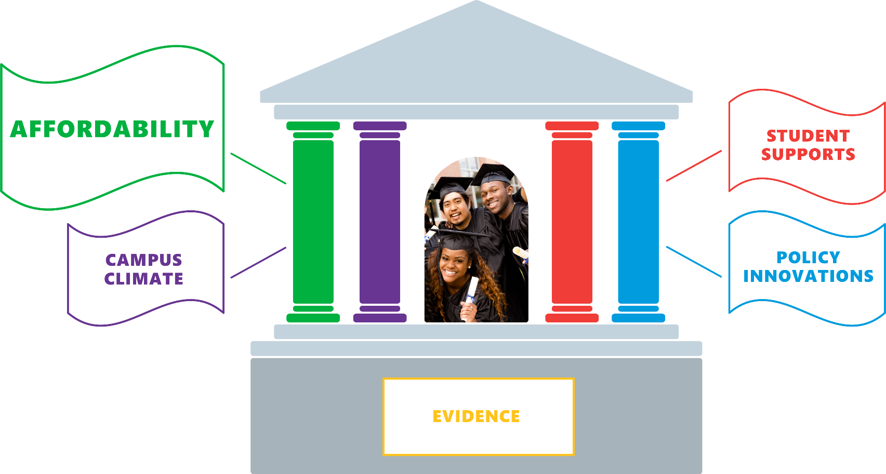
Pillars of Student Success
Advancing the Equity Agenda

Slide 7
Pillars of Student Success
Advancing the Equity Agenda Through Financial Aid Redesign and Beyond
AFFORDABILITY
Increasing access for students who have not enrolled due to cost
Understanding the difference between direct costs and total cost of attendance
Considering total cost of attendance and access to basic needs (childcare, food, housing, transportation)
Why?
Address unmet need on direct costs (tuition, fees, books and supplies) to reduce financial burden on students
Increase access to high-quality, postsecondary education

Slide 8
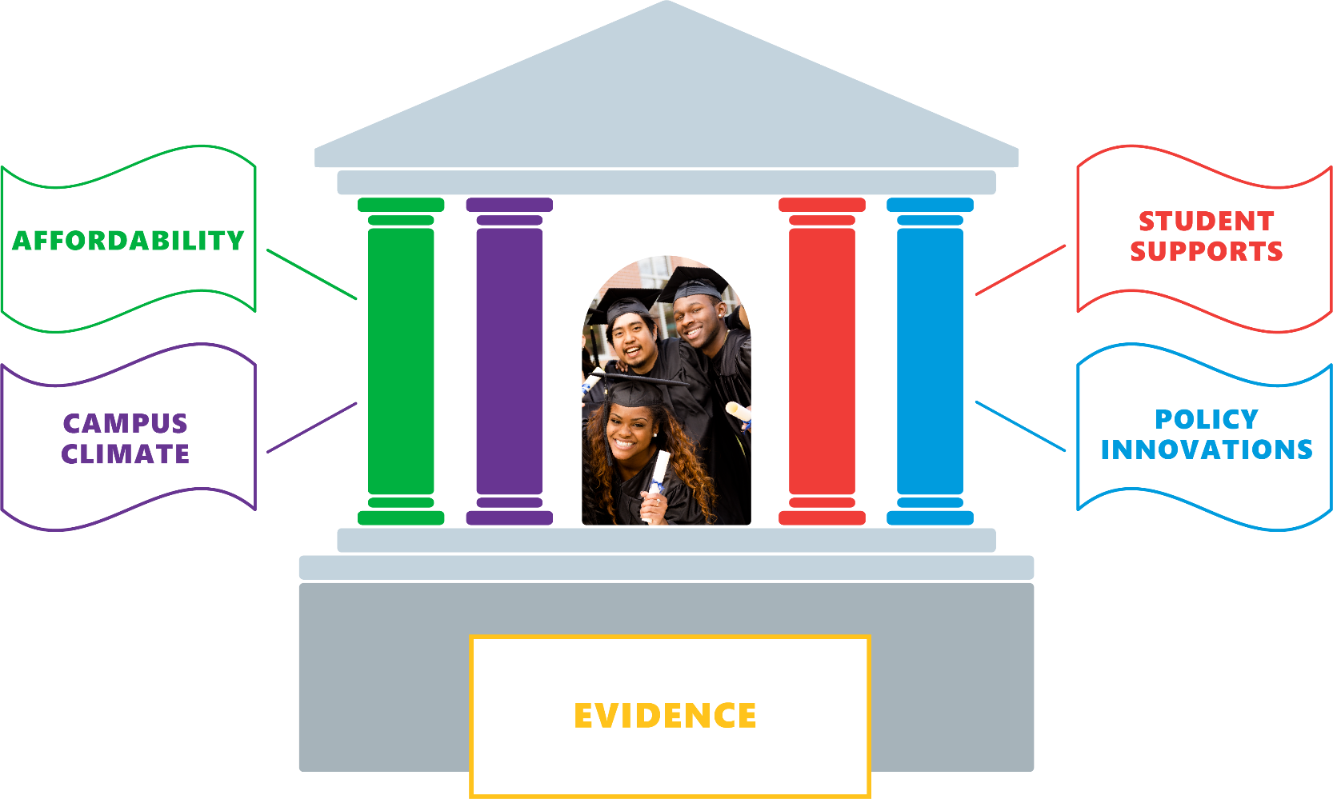
Pillars of Student Success
Advancing the Equity Agenda

Slide 9
Pillars of Student Success
Advancing the Equity Agenda
EVIDENCE
Enhancing data collection to identify impacts of specific programs and better evaluate existing policies
Collecting broader array of demographic and other factors that help predict or understand student outcomes
Conducting surveys to help us answer not just what happened with different subgroups, but why
Conducting market research to help us project impact of increased financial aid on access
Why?
To drive transformation, we must prioritize evidence over intuition and put data at the center of every conversation
Like most other states, Massachusetts needs a better & more complete higher ed data system, with the ability to analyze the experiences of all students

Slide 10
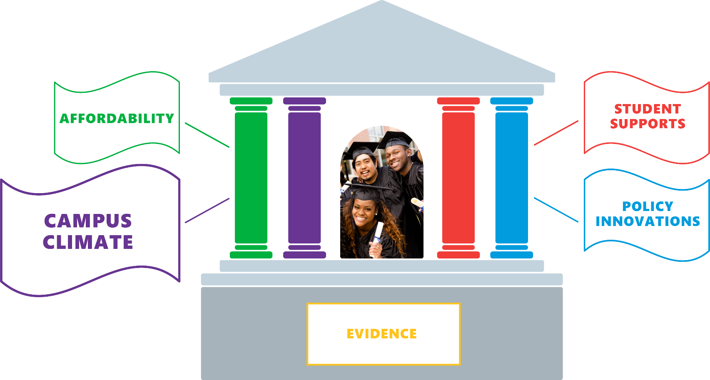
Pillars of Student Success
Advancing the Equity Agenda

Slide 11
Pillars of Student Success
Advancing the Equity Agenda
CAMPUS CLIMATE
Institutions of higher education must have welcoming environments for all students
Campus climate should be engaging and culturally responsive
Why?
Students perform better in culturally engaging environments (Museus, 2014)
Students are able to develop a sense of belonging (Strayhorn, 2018; Hurtado & Ponjuan, 2005)
Students cultural wealth (Yosso, 2005) is valued
Institutions become student-ready colleges and universities

Slide 12
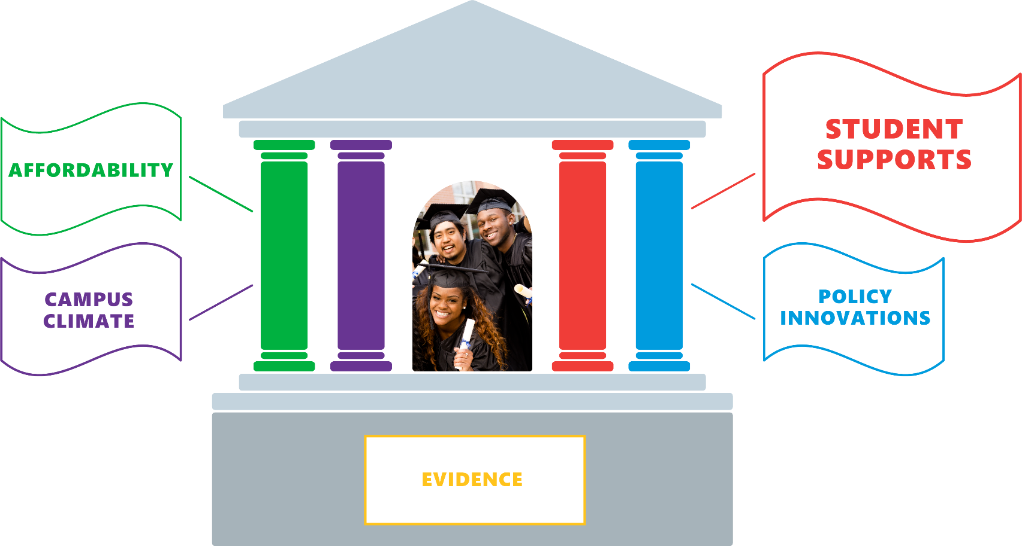
Pillars of Student Success
Advancing the Equity Agenda

Slide 13
Pillars of Student Success
Advancing the Equity Agenda
STUDENT SUPPORTS
Course & pathway to career advising
Financial aid advising
Including financial aid redesign
Tutoring
Mentoring
Mental health services
Why?
Evidence from other states suggests investing in culturally responsive wraparound support services improves (Mitchell, Wood, & Witherspoon, 2010) likelihood of student success, especially for students of color

Slide 14
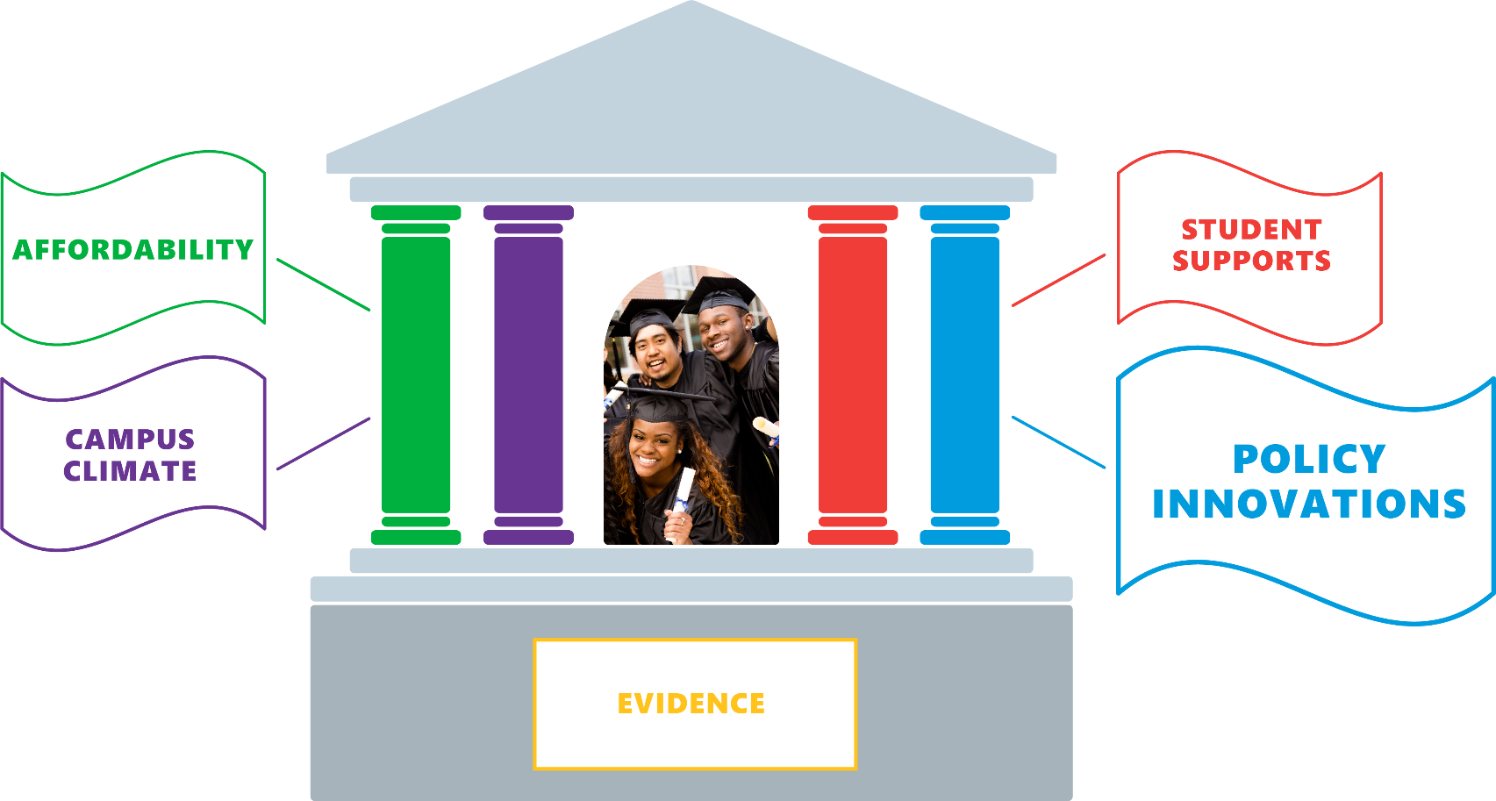
Pillars of Student Success
Advancing the Equity Agenda

Slide 15
Pillars of Student Success
Advancing the Equity Agenda
POLICY INNOVATIONS
Revise policies that hinder success
Identify promising innovative practices that can be replicated and scaled
Develop new policies that better support current and prospective students
Why?
Need to develop/improve policies and programs to better serve:
Early college students
Adult learners
Recognize existing structures were not originally designed to support culturally diverse students
Lessons learned from other states can prevent mistakes and duplication of effort

Slide 16
Pillars of Student Success
Advancing the Equity Agenda

Slide 17
FY2020 Presidential Evaluations
Advancing the Equity Agenda
Using the five Pillars of Student Success, how are you advancing the Equity Agenda at the institutional level?
Report on campus initiatives/ policies that seek to increase access and success rates for students from traditionally underserved backgrounds with particular focus on:
Affordability- MassGrant Plus;
Policy Innovations- Developmental Education Reform;
Evidence- Critical lens to examine outcomes

Slide 18
Pillars of Student Success – Institutional Level
Advancing the Equity Agenda
Affordability
Campus Climate
Climate Surveys
Evidence
Student Supports
Policy Innovations
Internal Policy Audit
Data-Informed Decision-Making
Wraparound Services
Expand OER
Developmental Education Reform
Expand Early College
Expand PLA
Diversify Faculty Corps
Critical Lens to Examine Outcomes
Learning Communities
MassGrant Plus

Slide 19
Questions & Discussion
Advancing the Equity Agenda

Slide 20
Questions for Campus Trustees
Advancing the Equity Agenda
What promising practices implemented at your campus that should be brought to scale across the system?

Slide 21
Questions for Campus Trustees
Advancing the Equity Agenda
What would be helpful as you advance the Equity Agenda at the campus-level?

